Slide 1




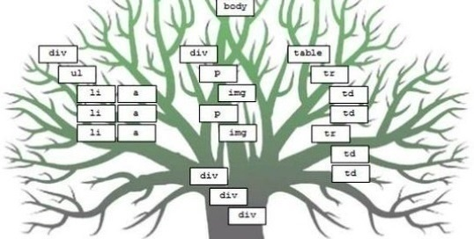
DOM
Document Object Model (DOM)
Advanced
JavaScript
SoftUni Team
Technical Trainers
Software University
http://softuni.bg

Slide 2


Table of Contents
The Built-In Browser Objects
Document Object Model (DOM)
The DOM API Overview
Selecting DOM Elements
NodeLists (Live & Static)

Slide 3


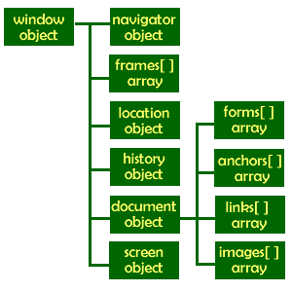
The Built-In Browser Objects

Slide 4
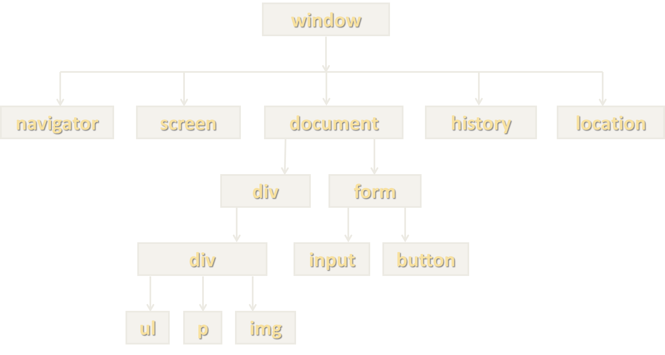
Built-in Browser Objects
The browser provides some read-only data via:
window
The top node of the DOM tree
Represents the browser's window
document
Holds information of the current loaded document
screen
Holds the user’s display properties
navigator
Holds information about the browser

Slide 5
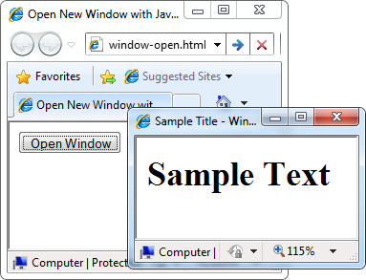
Opening New Window – Example
window.open()
window-open.html
var newWindow = window.open("", "sampleWindow", "width=300, height=100, menubar=yes, status=yes, resizable=yes");
newWindow.document.write(
"<html><head><title>
Sample Title</title>
</head><body><h1>Sample
Text</h1></body>");
newWindow.status =
"Hello folks";

Slide 6
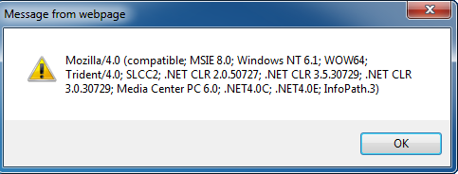
The Navigator Object
alert(window.navigator.userAgent);
The browser window
The navigator in the browser window
The userAgent (browser ID)

Slide 7
The Screen Object
document object
Provides some built-in arrays of specific objects on the currently loaded Web page
document.location
Used to access the currently open URL or redirect the browser
document.links[0].href = "yahoo.com";
document.write("This is some <b>bold text</b>");
document.location = "http://www.yahoo.com";

Slide 8
Built-In Browser Objects
Live Demo

Slide 9
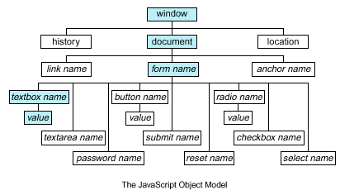
Document Object Model (DOM)

Slide 10
Document Object Model
What is Document Object Model (DOM)?
A concept of representing a HTML document as a "DOM tree"
Consists of elements that have child elements
Elements have properties (attribute + value) and events
DOM provides an API for traversing / modifying the DOM tree
Enables developers to modify the HTML content and the visual presentation of the currently loaded HTML document
E.g. load a table data (JSON) and show it as a HTML table

Slide 11
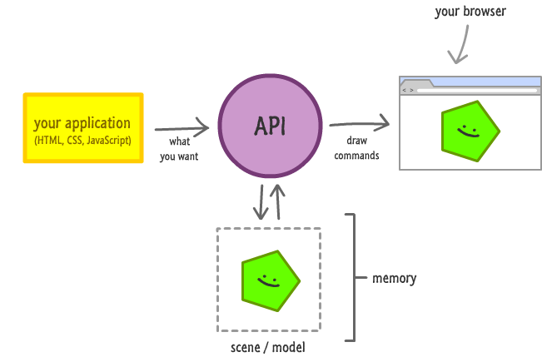
The DOM API

Slide 12
The DOM API
Web browsers provide a DOM API
Consists of objects and methods to interact with the HTML page
Can add / modify / remove HTML elements
Can add / modify / remove HTML attributes
Can apply CSS styles dynamically
HTML elements and their properties are mapped to JS objects
document.documentElement is the <html> element
document.body is the <body> element of the page

Slide 13
HTML Elements – Common Properties
All HTML elements have common properties
Corresponding to the their HTML attributes
id, className, style, onclick, etc.
innerHTML
Holds a string – the content of the element, without the element
outerHTML
Holds a string – the content of the element, with the element
innerText / textContent
Holds a string – the text content of the element, without the tags

Slide 14
DOM Objects and Types
Each HTML element has a corresponding DOM object type
HTMLLIElement represents <li>
HTMLAudioElement represents <audio>
Each of these objects have its specific properties
HTMLAnchorElement has href property
HTMLImageElement has src property
HTMLInputElement has value property
The document object is a special object
It represents the entry point for the DOM API (the DOM tree root)

Slide 15

DOM Objects
Live Demo

Slide 16
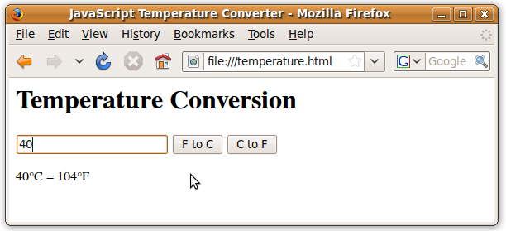
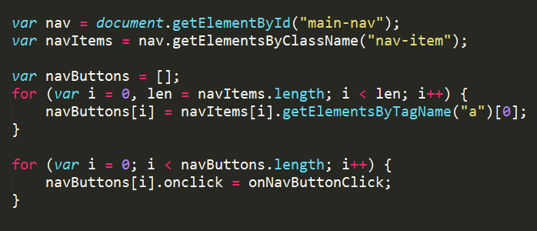
Selecting DOM Elements

Slide 17
Selecting HTML Elements from DOM
Select a single element → returns HTMLElement
Select a collection of elements → returns a collection
Access the predefined collections of elements
var header = document.getElementById('header');
var nav = document.querySelector('#main-nav');
var inputs = document.getElementsByTagName('li');
var radiosGroup = document.getElementsByName('genders[]');
var header = document.querySelectorAll('#main-nav li');
var links = document.links;
var forms = document.forms;

Slide 18
Selecing with document.getElementsBy…
Select element by ID → returns HTMLElement
Select elements by CSS class → returns a collection
Select elements tag name → returns a collection
Select element by name (in forms) → returns a collection
var header = document.getElementById('header');
var posts = document.getElementsByClassName('post-item');
var sidebars = document.getElementsByTagName('sidebar');
var gendersGroup = document.getElementsByName('genders[]');

Slide 19

document.getElementsBy…
Live Demo

Slide 20
Query Selectors
CSS-like selectors for accessing the DOM tree
querySelector(…)
Returns the first element that matches the selector
querySelectorAll(…)
Returns a collection of all elements that match the selector
var header = document.querySelector('#header');
var tableCells = document.querySelectorAll('table tr td');
var selectedLi = document.querySelector('menu > li.selected');
var specialLinks = document.querySelectorAll('a.special');

Slide 21
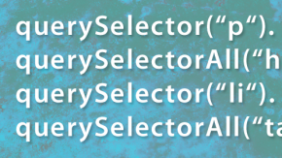
Query Selectors
Live Demo

Slide 22
Selecting Inner Elements
HTML elements support select for their inner elements
Select all DIVs that are inside an element with id "wrapper"
All methods can be used on HTML elements
Except getElementById()
var wrapper = document.getElementById('wrapper');
var divsInWrapper = wrapper.getElementsByTagName('div');

Slide 23

Selecting Inner Elements
Live Demo

Slide 24
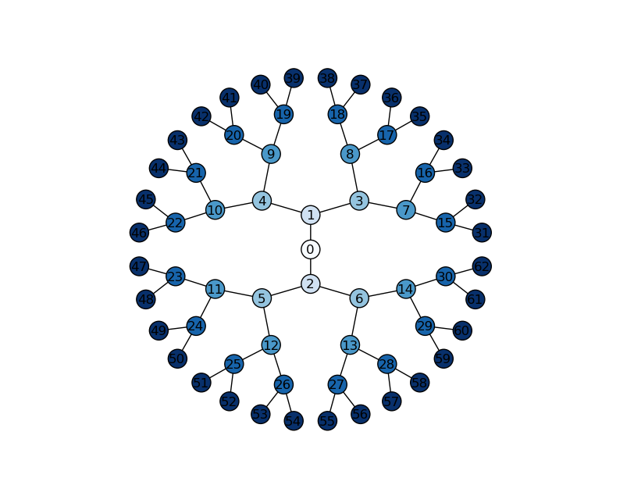
NodeList

Slide 25
NodeList
A NodeList is a collection returned by the DOM selectors:
getElementsByTagName(tagName)
getElementsByName(name)
getElementsByClassName(className)
querySelectorAll(selector)
https://developer.mozilla.org/en/docs/Web/API/NodeList
var divs = document.getElementsByTagName('div');
var queryDivs = document.querySelectorAll('div');
divs.forEach(function(div) {
// Do something with div …
}

Slide 26

NodeList
Live Demo

Slide 27

Static NodeList & Live NodeList

Slide 28
Static and Live NodeList
There are two kinds of NodeList collections
getElementsBy…() returns a live NodeList
querySelectorAll() returns a static NodeList
Live lists keep track of the selected elements
Even when changes are made to the DOM
While static list contain the elements as they were at the execution of the method
Keep in mind that live NodeList is slower than a regular array
Need to cache its length for better performance

Slide 29

Static NodeList and Live NodeList
Live Demo

Slide 30
Traversing the DOM
body
header
div#wrapper
footer
h1#logo
nav #main-nav
h2
nav
Create, Remove, Alter and Append HTML Elements

Slide 31
Traversing the DOM
DOM elements know their position in the DOM tree
Parent: element.parentNode
Returns the direct parent of the element (null for the document)
Children: element.childNodes
Returns a NodeList of all the child nodes (including the text nodes)
First / last child – element.firstChild / element.lastChild
Siblings (elements around the element):
element.nextSibling / element.nextElementSibling
element.previousSibling / element.previousElementSibling

Slide 32
Traversing the DOM – Example
var trainersList =
document.getElementsByClassName("trainers-list")[0];
var parent = trainersList.parentNode;
log("parent of trainers-list: " + parent.nodeName +
" with id: " + parent.id);
var children = trainersList.childNodes;
log("elements in trainers-list: " + children.length);
log("element in trainers-list");
Children.forEach(function(child){
var subItem = child;
log(subItem.nodeName + " content: " + subItem.innerText);
}

Slide 33
Manipulating the DOM
DOM can be manipulated dynamically with JS
HTML elements can be created
HTML elements can be removed
HTML elements can be altered
Change their content
Change their styles
Change their attributes

Slide 34
Creating HTML Elements
The document object can create new HTML elements
document.createElement(elementName)
Newly created elements are not in the DOM (the web page)
Must be appended to DOM manually
var studentsList = document.createElement("ul");
var liElement = document.createElement("li");
liElement.innerText = "Student: Pesho";
studentsList.appendChild(liElement);
document.body.appendChild(studentsList);

Slide 35
Inserting Elements Before / After Element
The DOM API supports inserting a element before or after a specific element
element.appendChild(child)
Inserts the element always at the end of the DOM element
parent.insertBefore(newNode, specificElement)
Inserts the element before specific element
parent.insertAfter(newNode, specificElement)
Inserts the element after specific element

Slide 36
Removing Elements
Elements can be removed from the DOM
Using element.removeChild(elToRemove)
Pass the element-to-remove to their parent
var trainers = document.getElementsByTagName("ul")[0];
var trainer = trainers.firstChild;
trainers.removeChild(trainer);
// Remove a selected element
var selectedElement = //select the element
selectedElement.parentNode.removeChild(selectedElement);

Slide 37
Altering the Elements
DOM elements can be changed and removed
With the DOM API each DOM element node can be altered
Change its properties or appearance
<div id="f"><p id="the-p">text</p></div>
<div id="s"></div>
…
var second = document.getElementById("s");
var theP = document.getElementById("the-p");
second.appendChild(theP);
…
// The DOM is:
<div id="f"></div>
<div id="s"><p id="the-p">text</p></div>

Slide 38
Appending DOM Elements
The DOM API supports appending DOM elements to an element
parentNode.appendChild(node)
Appends the DOM element node to the DOM element parentNode
If parentNode is appended to the DOM, the childNode is also appended

Slide 39

DOM Optimizations

Slide 40
Optimizing the Appending of Elements
Appending elements to the DOM is a very slow operation
When an elements is appended to the DOM, the DOM is rendered anew
All newly created elements must be appended together
Here comes the DocumentFragment element
It is a minimal DOM element, with no parent
It is used to store ready-to-append elements and append them at once to the DOM

Slide 41
Using DocumentFragment
Using DocumentFragment
Append the elements to a DocumentFragment
Appending DocumentFragment to the DOM appends only its child elements
http://ejohn.org/blog/dom-documentfragments/
var div = document.createElement('div');
var dFrag = document.createDocumentFragment();
dFrag.appendChild(div);
document.body.appendChild(dFrag);

Slide 42


Summary
Document Object Model (DOM)
The DOM API
Selecting DOM elements
NodeLists (live & static)
Creating / modifying / deleting elements
JS Basics

Slide 43








JavaScript DOM and Events
https://softuni.bg/courses/advanced-javascript/

Slide 44
License
This course (slides, examples, demos, videos, homework, etc.) is licensed under the "Creative Commons Attribution-NonCommercial-ShareAlike 4.0 International" license
Attribution: this work may contain portions from
“JavaScript Basics" course by Telerik Academy under CC-BY-NC-SA license

Slide 45





Free Trainings @ Software University
Software University Foundation – softuni.org
Software University – High-Quality Education, Profession and Job for Software Developers
softuni.bg
Software University @ Facebook
facebook.com/SoftwareUniversity
Software University @ YouTube
youtube.com/SoftwareUniversity
Software University Forums – forum.softuni.bg

